Slide 1

Data Analytics Phase

Slide 2
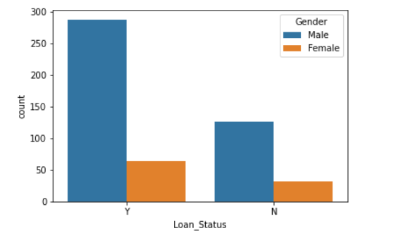
Hypothesis generation:
Gender:
Research question: Does Gender has significant impact on Loan approval feature?
Null Hypothesis: Gender has significant impact on loan approval feature
Alternative hypothesis: Gender has no impact on loan approval feature
Graph: From the graph we conclude that Gender has significant impact on Loan
approval feature
Chi-square test: From the chi-square test we got p value as 0.69, which is greater than 0.05, hence we are accepting null hypothesis, i.e., Gender feature is showing significant impact on loan approval feature
Over all conclusion: Both the graph and the chi-square test, is supporting same that is gender feature is impacting loan approval status

Slide 3
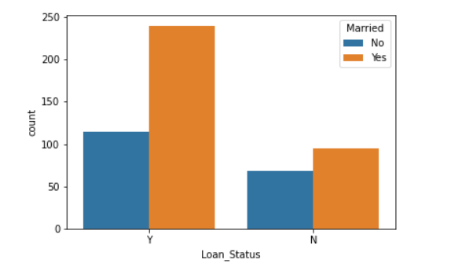
Hypothesis generation:
Married:
Research question: Does Married has significant impact on Loan approval feature?
Null Hypothesis: Married has significant impact on loan approval feature
Alternative hypothesis: Married has no impact on loan approval feature
Graph: From the graph we conclude that Married has significant impact on Loan
approval feature
Chi-square test: From the chi-square test we got p value as 0.04, which is less than 0.05, hence we are rejecting null hypothesis, i.e., Gender feature is not showing significant impact on loan approval feature
Over all conclusion: We got some contradictory conclusions from graph and chi-square test, as graph supporting null hypothesis and chi-square test rejecting null hypothesis.

Slide 4
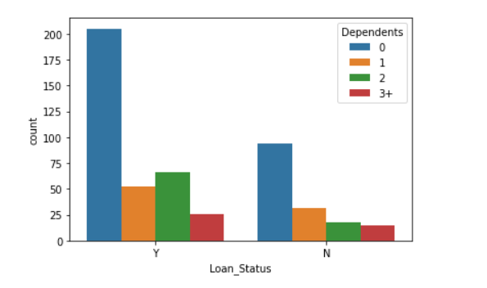
Hypothesis generation:
Dependents:
Research question: Does Dependents has significant impact on Loan approval feature?
Null Hypothesis: Dependents has significant impact on loan approval feature
Alternative hypothesis: Dependents has no impact on loan approval feature
Graph: From the graph we conclude that Dependents has significant impact on Loan
approval feature
Chi-square test: From the chi-square test we got p value as 0.10, which is greater than 0.05, hence we are accepting null hypothesis, i.e., Dependents feature is showing significant impact on loan approval feature
Over all conclusion: Both the graph and the chi-square test, is supporting same that is dependents feature is impacting loan approval status

Slide 5
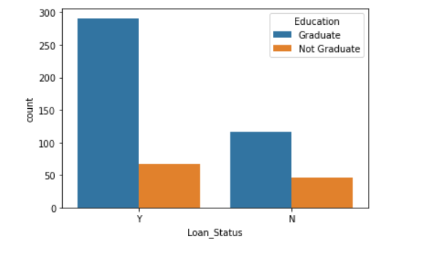
Hypothesis generation:
Education:
Research question: Does Education has significant impact on Loan approval feature?
Null Hypothesis: Education has significant impact on loan approval feature
Alternative hypothesis: Education has no impact on loan approval feature
Graph: From the graph we conclude that Education has significant impact on Loan
approval feature
Chi-square test: From the chi-square test we got p value as 0.01, which is less than 0.05, hence we are rejecting null hypothesis, i.e., Education feature is not showing significant impact on loan approval feature
Over all conclusion: We got some contradictory conclusions from graph and chi-square test, as graph supporting null hypothesis and chi-square test rejecting null hypothesis.

Slide 6
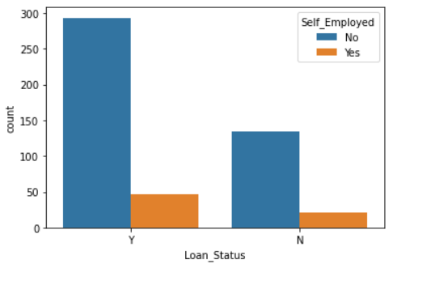
Hypothesis generation:
Self-Employed:
Research question: Does self-employed has significant impact on Loan approval feature?
Null Hypothesis: Self-employed has significant impact on loan approval feature
Alternative hypothesis: Self-employed has no impact on loan approval feature
Graph: From the graph we conclude that Self-employed has significant impact on Loan
approval feature
Chi-square test: From the chi-square test we got p value as 1.0, which is greater than 0.05, hence we are accepting null hypothesis, i.e., Self-employed feature is showing significant impact on loan approval feature
Over all conclusion: Both the graph and the chi-square test, is supporting same that is self-employed feature is impacting loan approval status

Slide 7
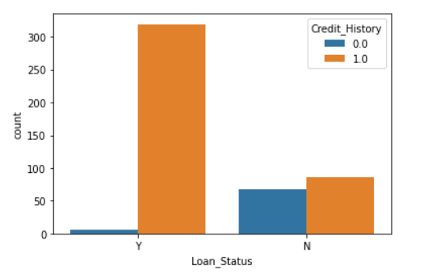
Hypothesis generation:
Credit_History:
Research question: Does Credit-history has significant impact on Loan approval feature?
Null Hypothesis: Credit-history has significant impact on loan approval feature
Alternative hypothesis: Credit-history has no impact on loan approval feature
Graph: From the graph we conclude that Credit-history has significant impact on Loan
approval feature
Chi-square test: From the chi-square test we got p value as 6.52, which is greater than 0.05, hence we are accepting null hypothesis, i.e., Credit-history feature is showing significant impact on loan approval feature
Over all conclusion: Both the graph and the chi-square test, is supporting same that is Credit-history feature is impacting loan approval status

Slide 8
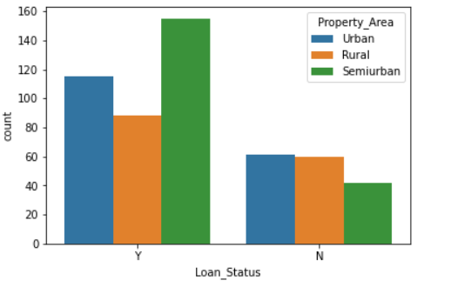
Hypothesis generation:
Property Area:
Research question: Does Property area has significant impact on Loan approval feature?
Null Hypothesis: Property area has significant impact on loan approval feature
Alternative hypothesis: Property area has no impact on loan approval feature
Graph: From the graph we conclude that property area has significant impact on Loan
approval feature
Chi-square test: From the chi-square test we got p value as 0.0003, which is less than 0.05, hence we are rejecting null hypothesis, i.e., property area feature is not showing significant impact on loan approval feature
Over all conclusion: We got some contradictory conclusions from graph and chi-square test, as graph supporting null hypothesis and chi-square test rejecting null hypothesis.

Slide 9
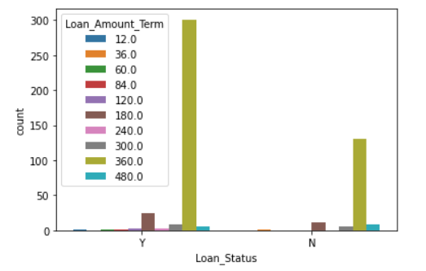
Hypothesis generation:
Loan amount term:
Research question: Does loan amount term has significant impact on Loan
approval feature?
Null Hypothesis: Loan amount term has significant impact on loan approval feature
Alternative hypothesis: Loan amount term has no impact on loan approval feature
Graph: From the graph we conclude that loan amount term has significant impact on Loan
approval feature
Chi-square test: From the chi-square test we got p value as 0.2, which is greater than 0.05, hence we are accepting null hypothesis, i.e., loan amount term feature is showing significant impact on loan approval feature
Over all conclusion: Both the graph and the chi-square test, is supporting same that is loan amount term feature is impacting loan approval status

Slide 10
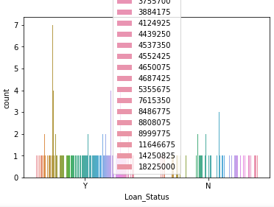
Hypothesis generation:
Applicant Income:
Research question: Does Applicant income has significant impact on Loan approval
feature?
Null Hypothesis: Applicant income has significant impact on loan approval feature
Alternative hypothesis: Applicant income has no impact on loan approval feature
Graph: From the graph we conclude that Applicant income does not have
significant impact on Loan approval feature
Chi-square test: From the chi-square test we got p value as 1.58e-71, which is lesser than 0.05, hence we are rejecting null hypothesis, i.e., Applicant income feature is not showing significant impact on loan approval feature
Over all conclusion: Both the graph and the chi-square test, is supporting same that is Applicant income feature is not impacting loan approval status

Slide 11
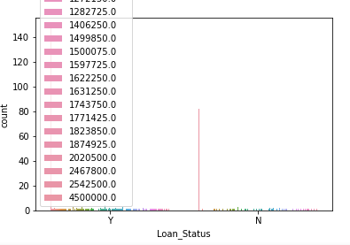
Hypothesis generation:
Co Applicant Income:
Research question: Does co applicant income has significant impact on Loan
approval feature?
Null Hypothesis: co applicant income has significant impact on loan approval
feature
Alternative hypothesis: Co applicant income has no impact on loan approval feature
Graph: From the graph we conclude that co-applicant income does not have
significant impact on Loan approval feature
Chi-square test: From the chi-square test we got p value as 9.76e-55, which is lesser than 0.05, hence we are rejecting null hypothesis, i.e., Co-applicant income feature is not showing significant impact on loan approval feature
Over all conclusion: Both the graph and the chi-square test, is supporting same that is co-applicant income feature is not impacting loan approval status

Slide 12
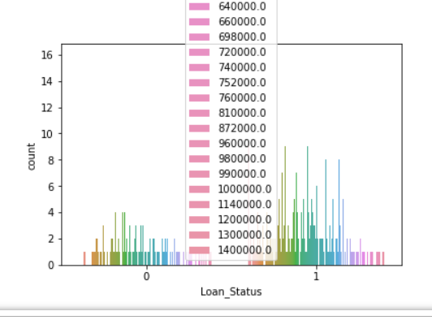
Hypothesis generation:
Loan Amount:
Research question: Does Loan amount has significant impact on Loan approval feature?
Null Hypothesis: Loan amount has significant impact on loan approval feature
Alternative hypothesis: Loan amount has no impact on loan approval feature
Graph: From the graph we conclude that loan amount does not have significant
impact on Loan approval feature
Chi-square test: From the chi-square test we got p value as 6.64e-194, which is less than 0.05, hence we are rejecting null hypothesis, i.e., Loan amount feature is not showing significant impact on loan approval feature
Over all conclusion: Both the graph and the chi-square test, is supporting same that is loan amount feature is not impacting loan approval status

Slide 13
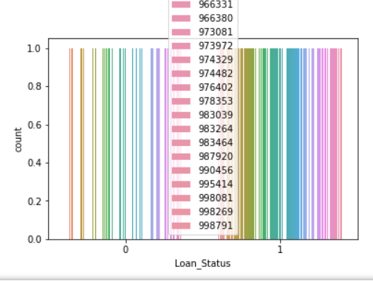
Hypothesis generation:
Loan ID:
Research question: Does Loan ID has significant impact on Loan approval feature?
Null Hypothesis: Loan Id has significant impact on loan approval feature
Alternative hypothesis: Loan Id has no impact on loan approval feature
Graph: From the graph we conclude that Loan ID don’t have significant impact on
Loan approval feature. Rejecting null hypothesis.
Chi-square test: As the loan ID is unique ID, we cannot draw any inferences from it. Hence no need to do chi-square test. We can drop this feature.

Slide 14
Considering Applicant income, Co-applicant income and loan amount are very important features for any loan approval from the bank. As these amounts are different for different people, we are getting p value less than 0.05 after doing one way Anova and graph also showing that these features are not impacting. So, we can convert the amounts into low medium and high then these values will significantly impact loan approval status.
Some suggested new features:
Applicant income Range
Co-Applicant income Range
Loan amount Range
Total Income: Applicant income + Co-applicant income
Total amount Range

Slide 15
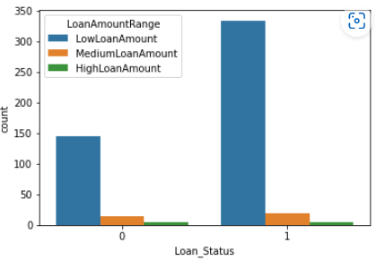
Hypothesis generation:
Loan Amount Range:
Research question: Does Loan amount Range has significant impact on Loan approval
feature?
Null Hypothesis: Loan amount Range has significant impact on loan approval feature
Alternative hypothesis: Loan amount Range has no impact on loan approval feature
Graph: From the graph we conclude that loan amount Range have significant
impact on Loan approval feature
Chi-square test: From the chi-square test we got p value as 0.23, which is greater than 0.05, hence we are accepting null hypothesis, i.e., Loan amount Range feature is showing significant impact on loan approval feature
Over all conclusion: Both the graph and the chi-square test, is supporting same that is loan amount range feature is impacting loan approval status

Slide 16
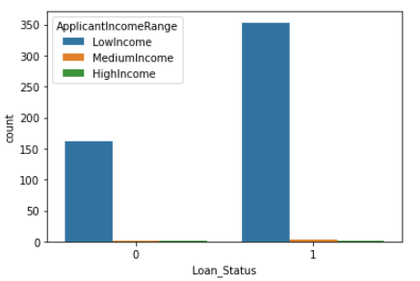
Hypothesis generation:
Applicant Income Range:
Research question: Does Applicant Income Range has significant impact on Loan approval
feature?
Null Hypothesis: Applicant income Range has significant impact on loan approval feature
Alternative hypothesis: Applicant Income Range has no impact on loan approval feature
Graph: From the graph we conclude that Applicant Income Range have significant
impact on Loan approval feature
Chi-square test: From the chi-square test we got p value as 0.73, which is greater than 0.05, hence we are accepting null hypothesis, i.e., Applicant income range feature is showing significant impact on loan approval feature
Over all conclusion: Both the graph and the chi-square test, is supporting same that is Applicant income range feature is impacting loan approval status

Slide 17
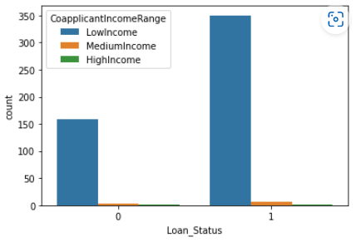
Hypothesis generation:
Co-applicant Income Range:
Research question: Does Co-applicant income Range has significant impact on Loan
approval feature?
Null Hypothesis: Co-applicant income range has significant impact on loan approval feature
Alternative hypothesis: Co-applicant income range has no impact on loan approval feature
Graph: From the graph we conclude that co-applicant income range have significant
impact on Loan approval feature
Chi-square test: From the chi-square test we got p value as 0.79, which is greater than 0.05, hence we are accepting null hypothesis, i.e., Co-applicant income range feature is showing significant impact on loan approval feature
Over all conclusion: Both the graph and the chi-square test, is supporting same that is co-applicant income feature is impacting loan approval status

Slide 18
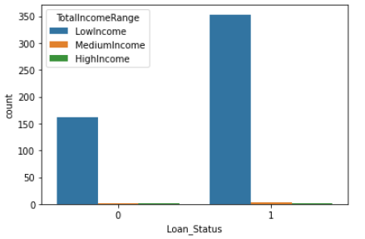
Hypothesis generation:
Total Income Range:
Research question: Does Total income Range has significant impact on Loan approval
feature?
Null Hypothesis: Total Income Range has significant impact on loan approval feature
Alternative hypothesis: Total Income range has no impact on loan approval feature
Graph: From the graph we conclude that Total income Range have significant
impact on Loan approval feature
Chi-square test: From the chi-square test we got p value as 0.73, which is greater than 0.05, hence we are accepting null hypothesis, i.e., Total income range feature is showing significant impact on loan approval feature
Over all conclusion: Both the graph and the chi-square test, is supporting same that is Total income range feature is impacting loan approval status

Slide 19
Over All Conclusion:
From the dataset after pre-processing and including new features we conclude that Gender, dependents, Self-employed, credit history, Loan amount term, Applicant income range, co-applicant income range, total income range, loan amount range are influencing our target variable loan approval status

